Slide 1
Effortless Efficiency: GitHub Codespaces, Templates, and Embracing YAGNI!

Slide 2



Slide 3
Let’s get started
Github CodeSpace 2. Github Templates
What is it ?
How to use it?
What’s in it for me?
3. YAGNI principle
tools takeaway about this approach

Slide 4

20XX
20XX
Microsoft acquires GitHub
20XX
20XX

Slide 5


20XX
20XX
Microsoft acquires GitHub
Microsoft Buying NPM Depend Bot
B
20XX
20XX

Slide 6

20XX
20XX
Microsoft acquires GitHub
Microsoft Buying NPM Depend Bot
B
Github Action
B
20XX
20XX

Slide 7

20XX
20XX
Microsoft acquires GitHub
Microsoft Buying NPM Depend Bot
B
Github Action
B
VS Code Rewrite in electron
20XX
20XX

Slide 8
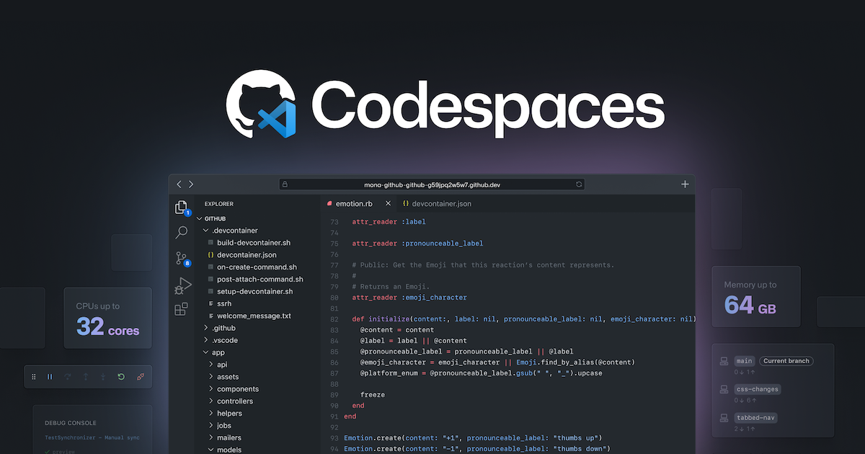

Slide 9
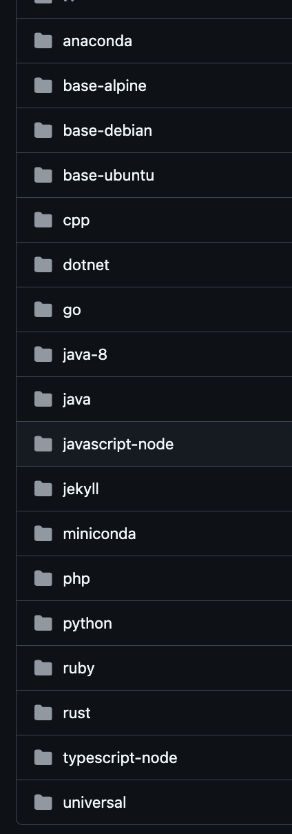

Pre-configured environment:
Codespaces provide a consistent development environment for your projects, with all required dependencies and tools pre-installed.

Slide 10

Code anywhere, anytime
Access your project from any device with an internet connection. You can seamlessly switch between machines without needing to set up a local environment.

Slide 11

Enhanced collaboration
With shared codespaces, team members can collaborate in real time, making it easier to work together on projects.

Slide 12


Slide 13
Wrap it up
From now on Use “.”!
Make it easy to navigate in new projects
Commit configuration changes without branching locally (apps-helm-charts)
Run Environment online in Remote
Work interviews ,Workshops etc..

Slide 14

Github Templates

Slide 15
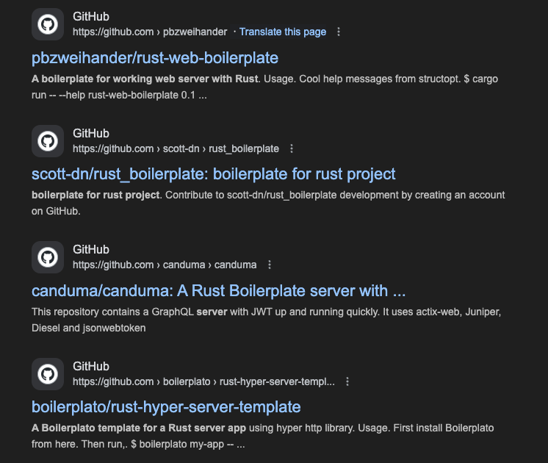
Github Templates

Slide 16
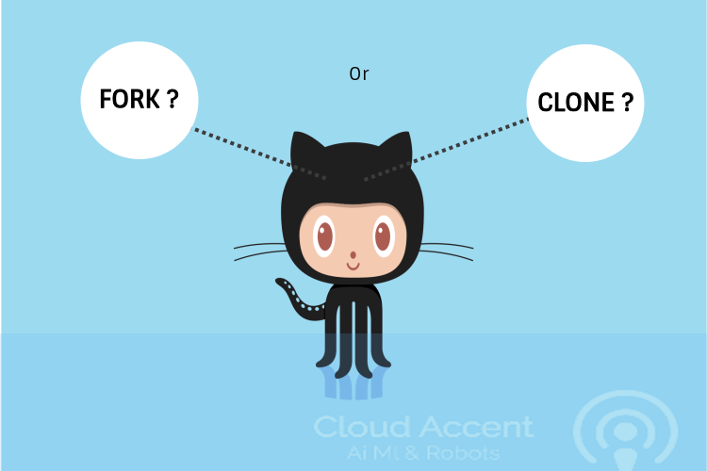

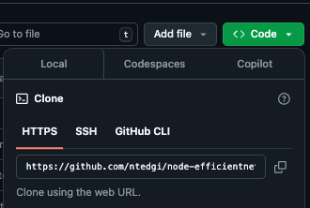
Github Templates

Slide 17

Github Templates
There is a need for special kind of repo
Just start coding without all the boiler plate

Slide 18
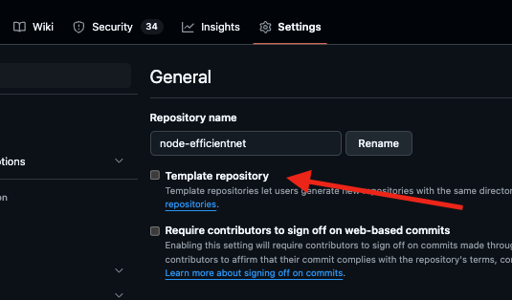
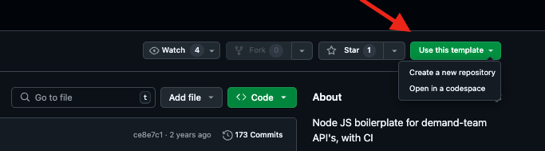
Github Templates

Slide 19
GitHub Templates: Consistent Code Structure
Reduce Code Duplication
Share common code, configurations, and style guidelines across your team.

Slide 20
GitHub Templates: Consistent Code Structure
Enforce Best Practices
Templates can enforce coding standards, naming conventions, and other best practices.

Slide 21
GitHub Templates: Consistent Code Structure
Accelerate Development
Start new projects with a solid foundation, saving time and effort for your development team.

Slide 22
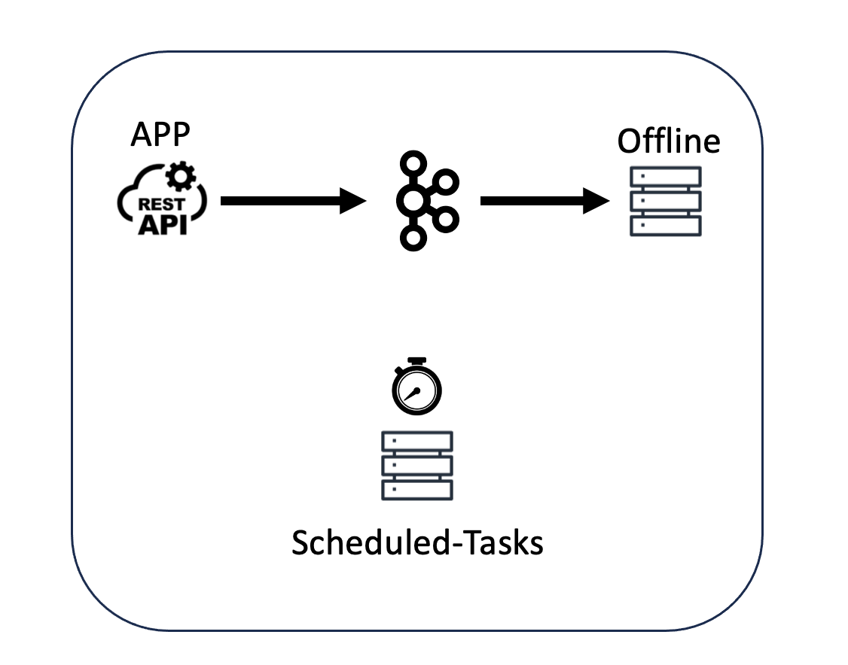
How We Use It ?
Http Server
Kafka Consumer /producer
Cron Job Runner

Slide 23
How We Use It ?
Http Server
Monitoring Agent
Mysql Client
Configurations
Redis Caching
Rate Limiting
Logger
Consumers /producers
Kafka Client
SQS Client
Cron Job Runner
Scheduler

Slide 24

How We Use It ?
Docker File
Unit Test And integration For Endpoints
Reusable github Actions
Deployment Script
Unit Tests / Coverage
Shared Github Action

Slide 25
How We Use It ?
After Cloning this Template your code has full CI from First line of code !@!

Slide 27
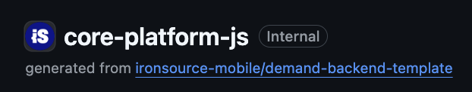
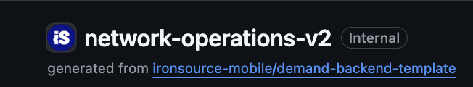
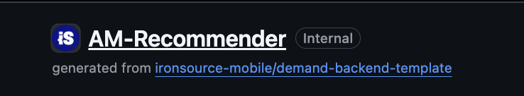


Slide 28


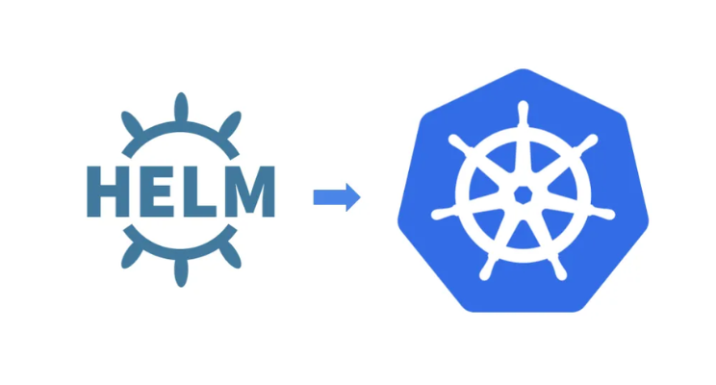

Slide 29
Wrap it up
Work
Reduce Code Duplication
Enforce Best Practices
Accelerate Development

Slide 30

KISS - "Keep it simple, stupid!"

Slide 31

KISS - "Keep it simple, stupid!"
DRY - "Don't repeat yourself"

Slide 32
YAGNI ??

Slide 33
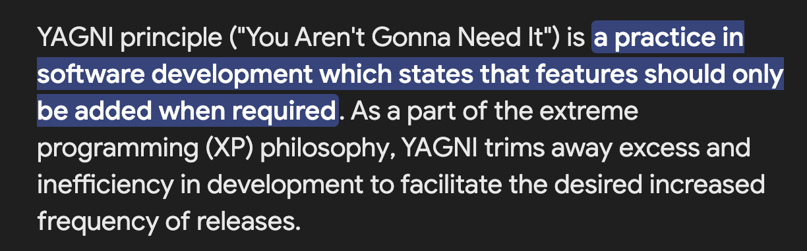
"You Aren't Gonna Need It"

Slide 34
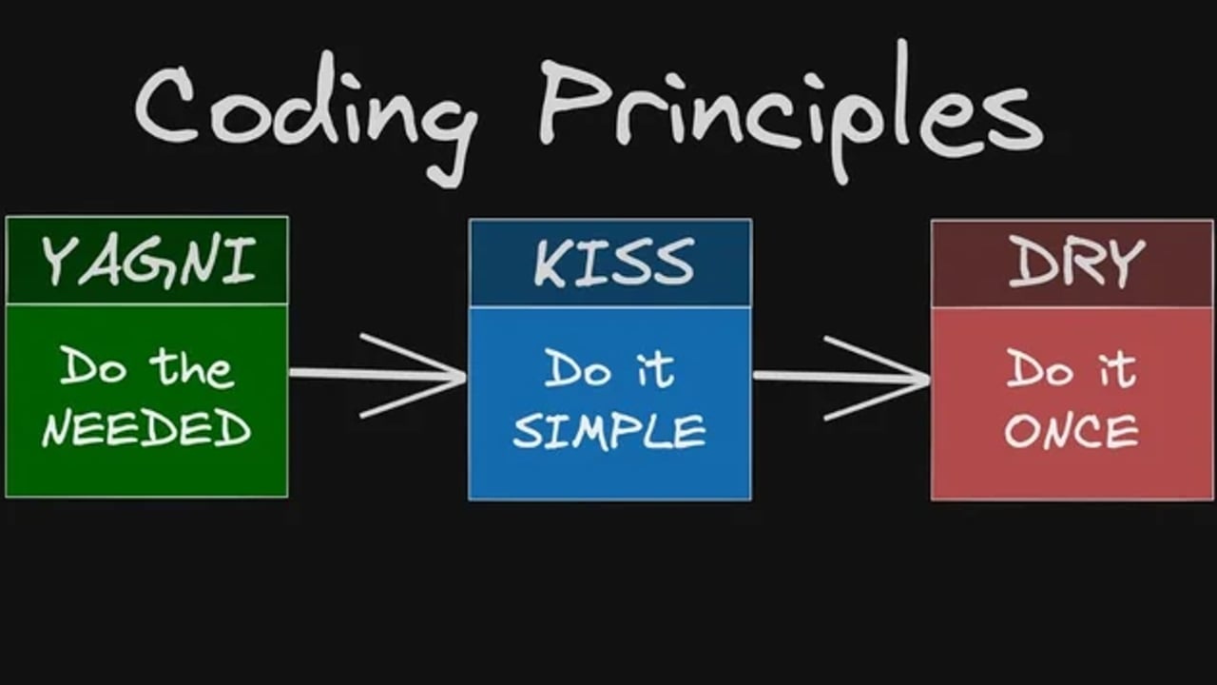

Slide 35


Slide 36


"You Aren't Gonna Need It"

Slide 37

"You Aren't Gonna Need It"

Slide 38

"You Aren't Gonna Need It"
S3 in free tier

Slide 39
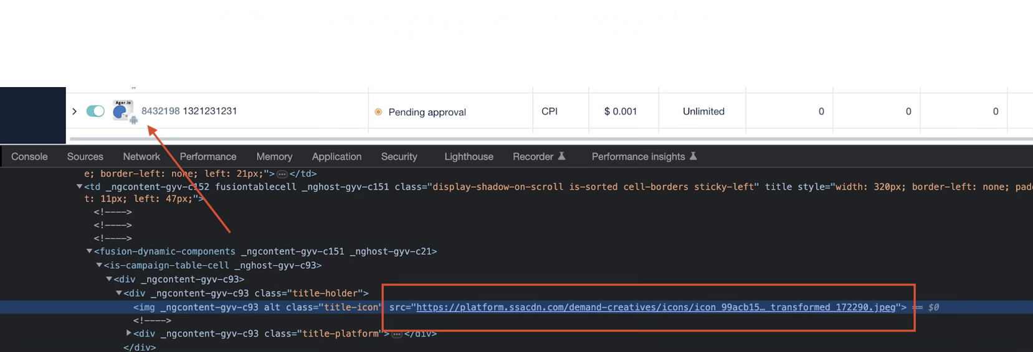
"You Aren't Gonna Need It"

Slide 40
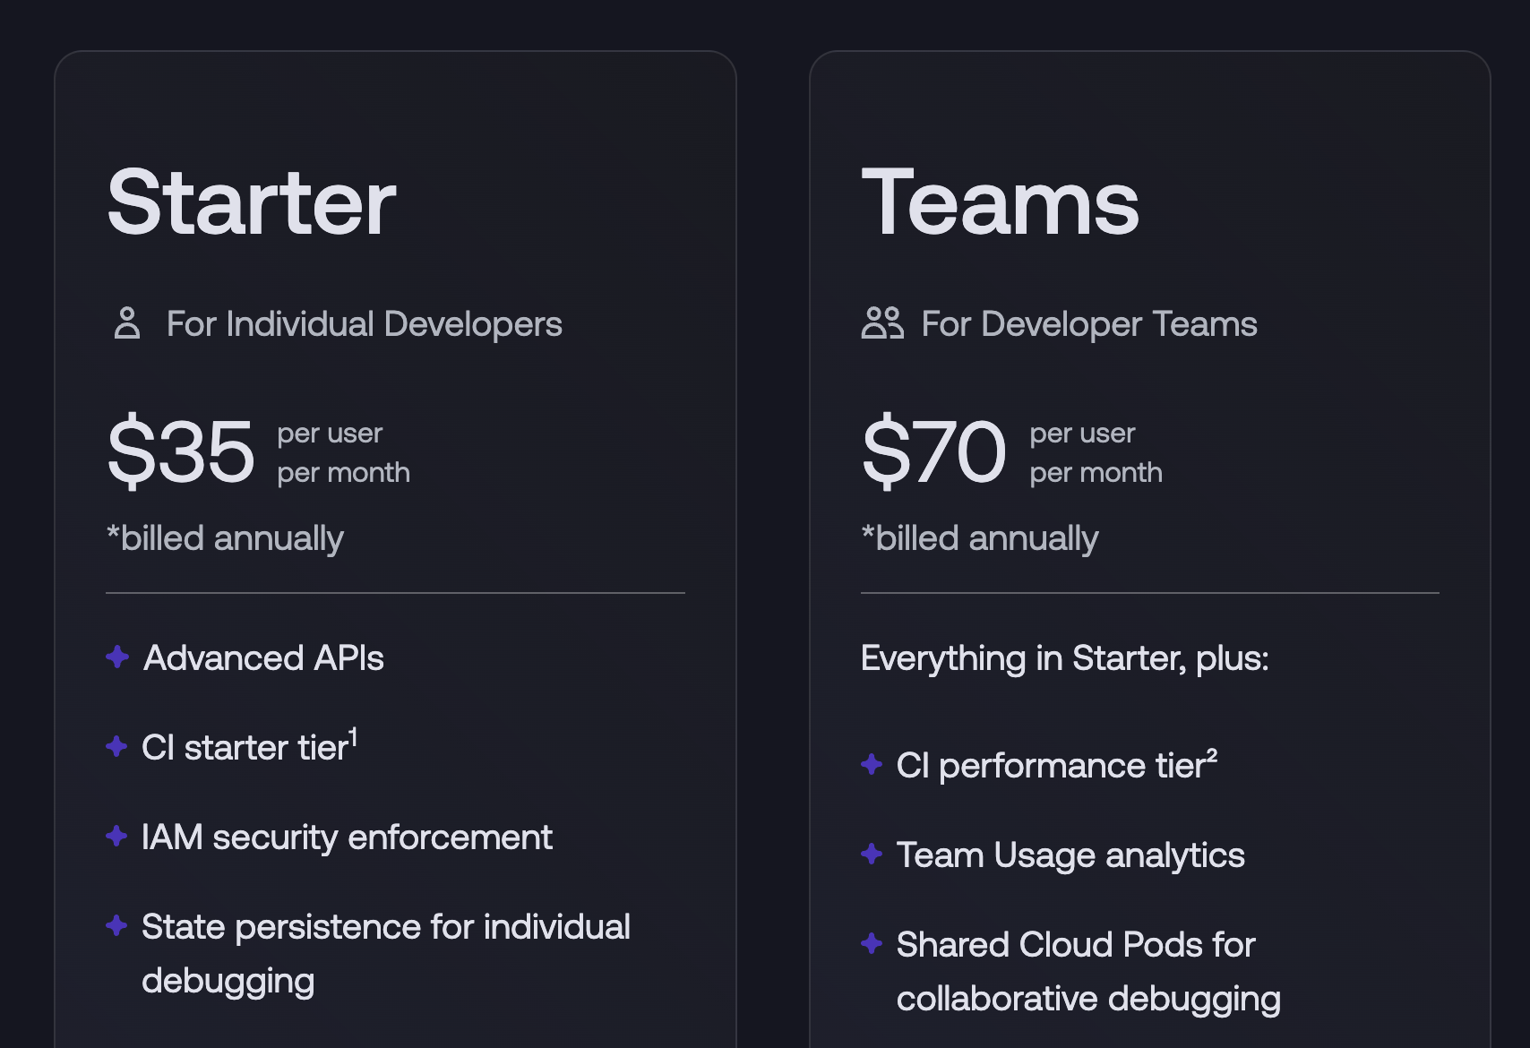
"You Aren't Gonna Need It"

Slide 41
"You Aren't Gonna Need It"
ALL Local AWS Services
Chaos Engineering
State Management
Security Testing
Cloud Sandbox

Slide 42
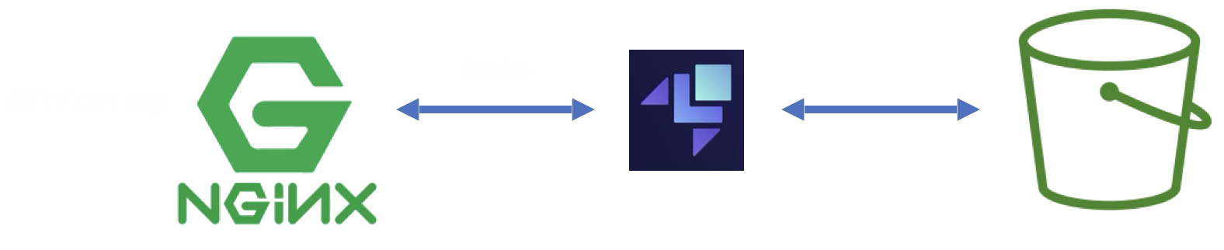
"You Aren't Gonna Need It"
is a web server that can also be used as a reverse proxy, load balancer, mail proxy and HTTP cache.

Slide 43
"You Aren't Gonna Need It"
MonoRepo
You Need to
Build /Compile
Run Tests
Run local
Deploy

Slide 44


"You Aren't Gonna Need It"
Affected Repositories in Workspace?
Affected Tests to Run?
Symbolic linking Packages ?
Caching Your resources for build on cloud?
One year free Dashboard for all your CI With Runs trends?

Slide 45

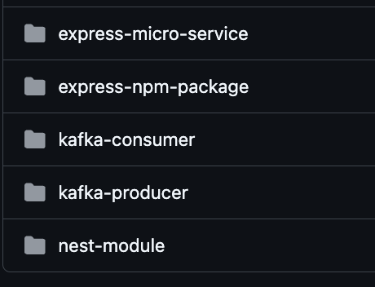
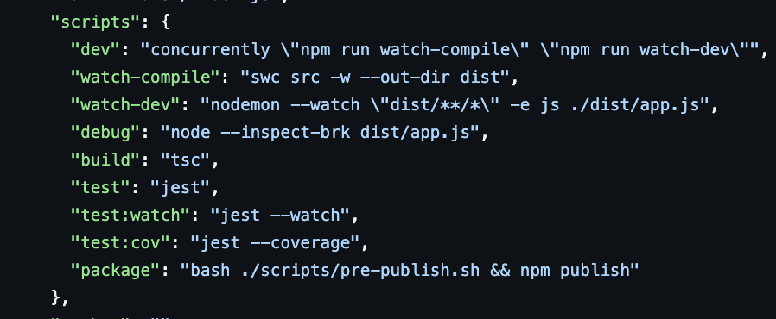
"You Aren't Gonna Need It"
https://github.com/ntedgi/monaorepo

Slide 46

Questions?

Slide 47
Thank you

